Slide 1
Quick Risk Estimation Tool for Integrated Climate and Disaster Risks (Climate QRE)

Slide 2
Climate QRE
Quick Risk Estimation Tool for Integrated Climate and Disaster Risks
A 'rapid’ and ‘simplified’ climate and disaster risk analysis tool to support cities and municipalities in making informed decisions about risk with essential information for immediate action.
Useful in situations where there is limited time or resources available to perform a detailed assessment.
Developed through a partnership between the Latin American Development Bank (CAF) and the United Nations Office for Disaster Risk Reduction (UNDRR) under the umbrella of the Making Cities Resilient 2030 (MCR2030) initiative in 2023.
*Note: this approach may not capture all the complexity and nuances of a comprehensive assessment, which often requires more time, resources and a detailed analysis. It cannot replace the scientific risk modeling and analysis.

Slide 3
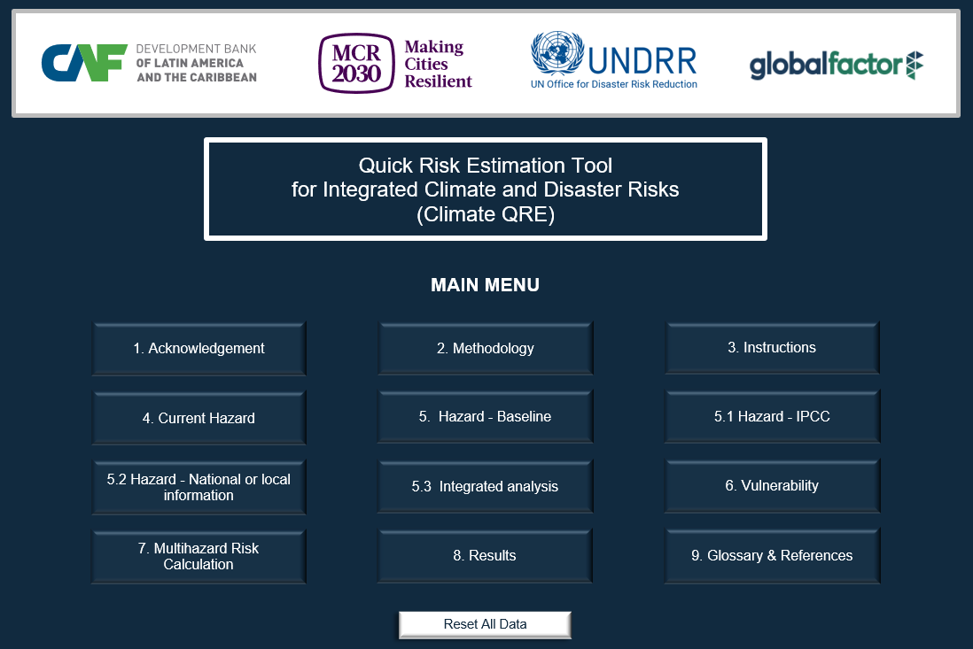
Structure of the Climate QRE Tool
Macro-enabled Excel Format
It has 24 active worksheets including
  1 Home page & 1 Menu page
  12 Instructional pages and reference → This is where the assessment is performed.
  10 pages for additional information on the vulnerability indicators
  On the menu page, a button to ‘Reset All Data’ is available
Notes:
Explain the structure of the Climate QRE Tool.
Noting that ‘Reset All Data’ button will erase all data in the worksheet except for the selection of the hazards. Once it is erased, the file and not be undone. Please be careful in using this button.

Slide 4
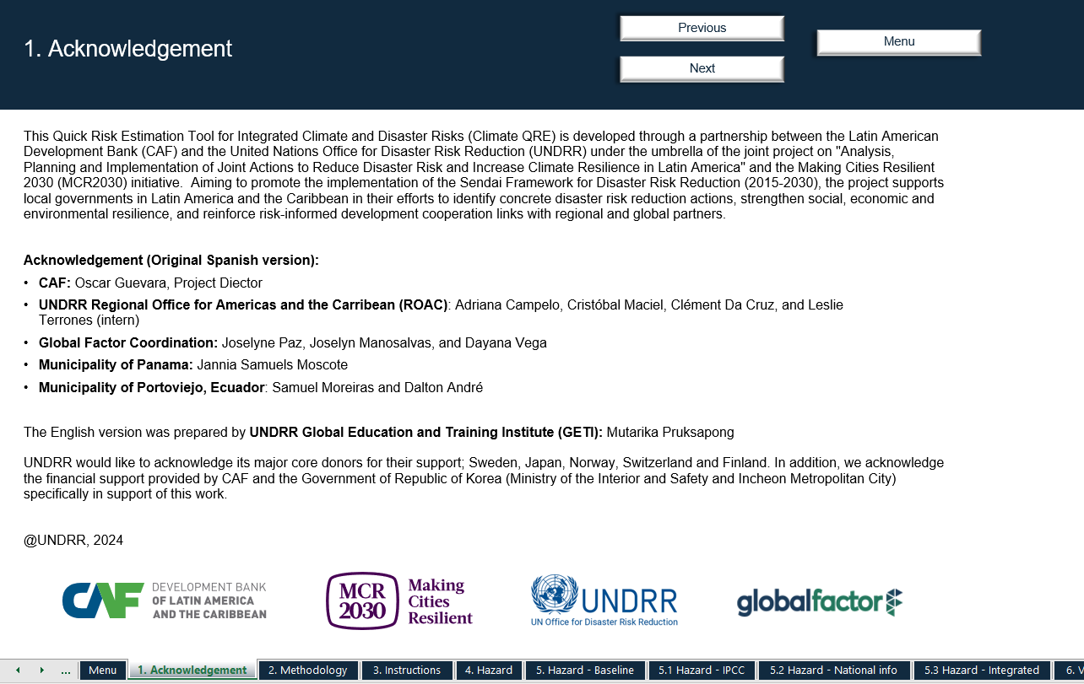
1. Acknowledgement
- Provides information about the development of this tool.
Notes:
Acknowledgement page provides information about the development of this tool.

Slide 5
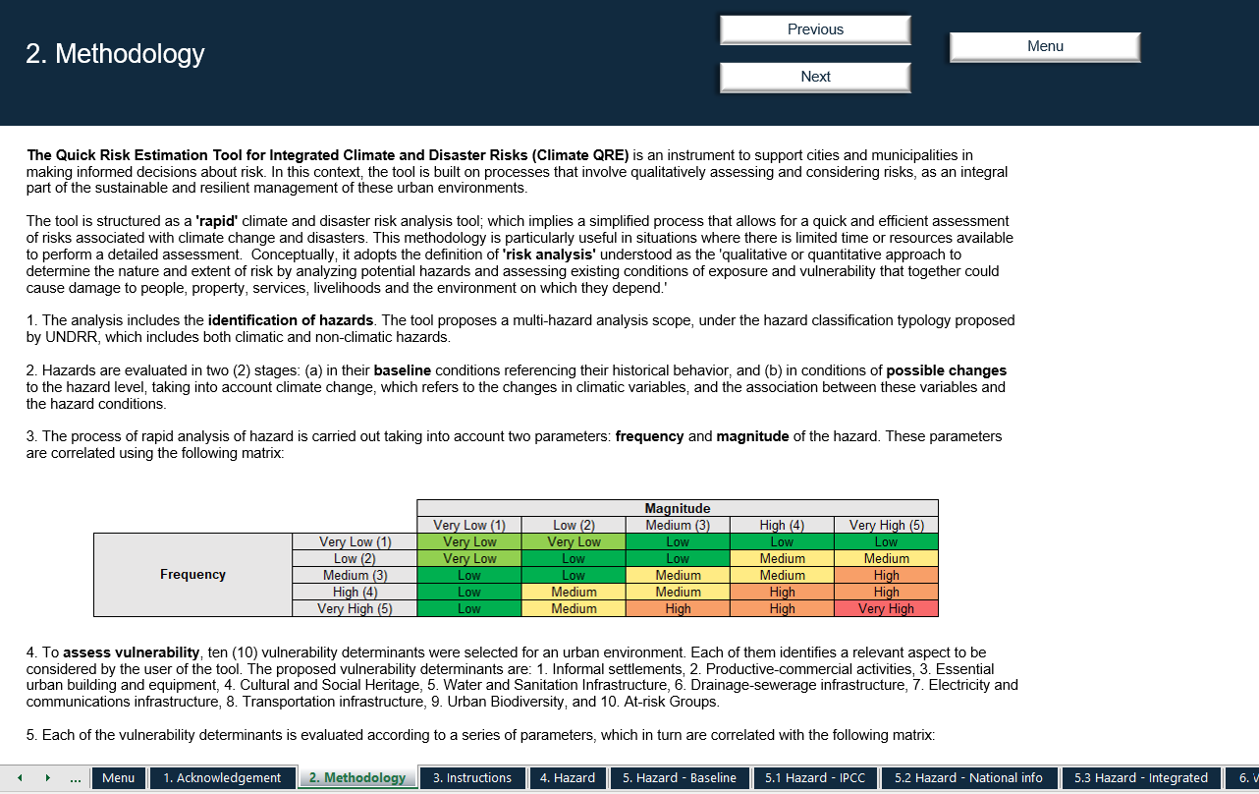
2. Methodology
– Explains what the Climate QRE Tool is, and the methodology used to analyze rapid risks.
Notes:
2. Methodology – Explains what the Climate QRE Tool is, and the methodology used to analyze rapid risks.

Slide 6
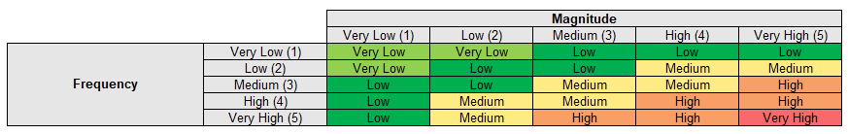
2. Methodology – cont.
1. The analysis includes the identification of hazards. The tool proposes a multi-hazard analysis scope, under the hazard classification typology proposed by UNDRR, which includes both climatic and non-climatic hazards.
2. Hazards are evaluated in two (2) stages:
in their baseline conditions referencing their historical behavior, and
in conditions of possible changes to the hazard level, taking into account climate change, which refers to the changes in climatic variables, and the association between these variables and the hazard conditions.
3. The process of rapid analysis of hazard is carried out taking into account two parameters: frequency and magnitude of the hazard. These parameters are correlated using the following matrix:

Slide 7
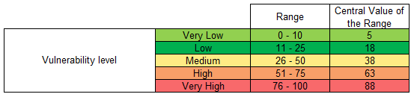
2. Methodology – cont.
4. To assess vulnerability, ten (10) vulnerability determinants were selected for an urban environment. Each of them identifies a relevant aspect to be considered by the user of the tool. The proposed vulnerability determinants are: 1. Informal settlements, 2. Productive-commercial activities, 3. Essential urban building and equipment, 4. Cultural and Social Heritage, 5. Water and Sanitation Infrastructure, 6. Drainage-sewerage infrastructure, 7. Electricity and communications infrastructure, 8. Transportation infrastructure, 9. Urban Biodiversity, and 10. At-risk Groups.
5. Each of the vulnerability determinants is evaluated according to a series of parameters, which in turn are correlated with the following matrix:
Notes:
2. Methodology – explains what QRE Tool is, the rational of the analysis process.

Slide 8
2. Methodology – cont.
6. The final step is the qualitative risk assessment. This assessment is based on the functional correlation between hazard conditions and vulnerability conditions. Considering that hazards are evaluated in two (2) stages: (a) in their baseline conditions; (b) in conditions of possible changes to the level of the hazard. Taking into account climate change, this tool proposes two risk evaluations: (a) baseline risk conditions; and (b) risk conditions with climate change.
Multi-hazard identification: climatic, geological, biological and technological
The frequency and magnitude of each hazard is analyzed according to local knowledge and information (Using a scale from 1 to 5).
Climate hazards and their changes are analyzed according to IPCC scenarios and National Communications.
Vulnerability is analyzed for 10 indicators
(Scale from 1 to 5)
The result is a value for baseline risk and future risk in the medium and short term
Harzards
Baseline Analysis
Climate Change Scenario Analysis
Vulnerability
Risk
Notes:
2. Methodology – explains what QRE Tool is, the rational of the analysis process.

Slide 9
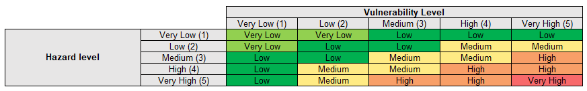
2. Methodology – cont.
7. The process of rapid analysis of risk conditions is carried out taking into account the two results of the previous stages: hazard condition and vulnerability condition. These parameters are correlated using the following matrix:
Notes:
2. Methodology – explains what QRE Tool is, the rational of the analysis process.

Slide 10
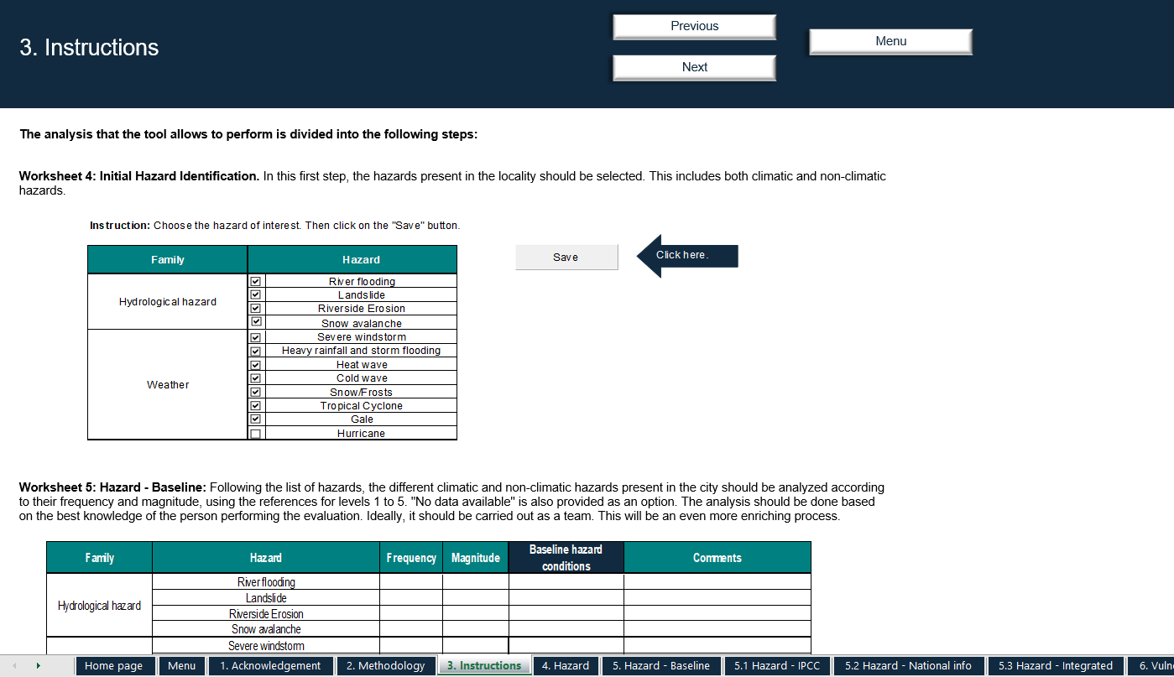
3. Instructions
– Provide instructions on how to use the Tool
Notes:
3. Instructions – Provide instructions on how to use the Tool

Slide 11
3. Instructions - Part 1: Hazards
Worksheet 4: Initial Hazard Identification
  Select the climatic and non-climatic hazards present in the locality for analysis
Worksheet 5: Hazard – Baseline
  Provide an analysis of each hazards in terms of 1) frequency and 2) magnitude
  Select a value from 1 (lowest) to 5 (highest)
Worksheet 5.1: Hazard – IPCC
  Select the respective regions. This will automatically add the expected change in hazard level (increase, decrease or unchanged) according to the IPCC regional climate change scenarios
Worksheet 5.2: Hazard – National Info
  This allows you to manually add additional information you have in terms of the climate change considerations according to your national or local data.
Baseline Risk
Climate change consideration
Worksheet 5.3 Hazard – Integrated
  NO INPUT NEEDED. This worksheet displays the integrated hazard analysis under climate change considerations, taking into account the inputs provided in Worksheet 5, 5.1 and 5.2
Notes:
3. Instructions – Provide instructions on how to use the Tool

Slide 12
3. Instructions - Part 2: Vulnerability and Risk Calculation
Worksheet 6. Vulnerability
  Select a value from 1 (lowest) to 5 (highest) reflecting the level of vulnerability indicators identified by the prioritized hazards by city.
  This part takes into account the exposure, vulnerability and coping capacity of the city to the selected hazards.
Worksheet 7. Risk Calculation
  NO INPUT NEEDED. This worksheet displays the results of risk analysis under 1) baseline risk information and 2) climate change considerations in the short- and medium-term.
Worksheet 8. Results
  NO INPUT NEEDED. This worksheet displays the bar graphs of the risk analysis.
Worksheet 9. Glossary & Reference
  Lists of key terms and reference documents
Notes:
3. Instructions – Provide instructions on how to use the Tool

Slide 13
Detailed steps to completing Climate QRE

Slide 14
Worksheet 4. Initial Hazard Identification
Worksheet 4. Initial Hazard Identification. In this first step, the hazards present in the locality should be selected. This includes both climatic and non-climatic hazards.
- Check the box(es) in front of the hazard you want to perform the analysis, then click ‘Save’
2
1

Slide 15
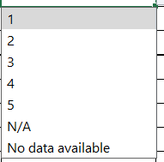
Worksheet 5. Hazard – Baseline
Worksheet 5. Hazard - Baseline: Following the list of hazards, the different climatic and non-climatic hazards present in the city should be analyzed according to their frequency and magnitude, using the references for levels 1 to 5 in respective "Frequency" and "Magnitude" Columns. "No data available" is also provided as an option.
Options available
Important Note: The analysis should be done based on the best knowledge of the person performing the evaluation. Ideally, it should be carried out as a team. This will be an even more enriching process.

Slide 16
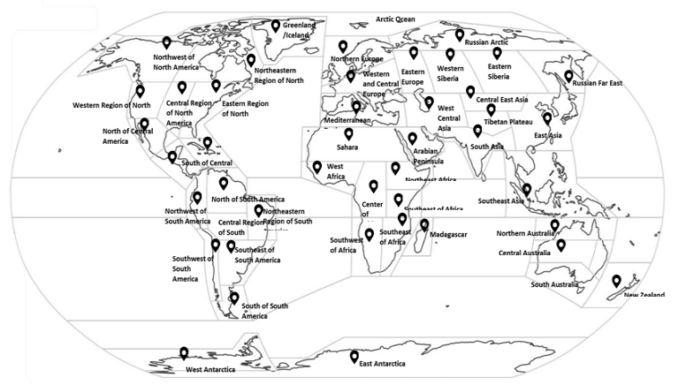
Worksheet 5.1 Hazard – IPCC
Worksheet 5.1 Hazard under climate change considerations, according to IPCC. The IPCC region where the city is located should be found on the map. Once identified, select it using the cursor. Once the region has been selected, it will be possible to see the future changes that occur for each type of climate hazard. This shows whether the manifestation of these phenomena increases, decreases or remains the same.

Slide 17
Worksheet 5.2 Hazard - National info
Worksheet 5.2 Hazard under climate change considerations with national or local data. Information on climate change should be sought on a national or local scale, depending on availability. Once the information has been identified, select the time period and emissions scenario under which changes are projected. Then indicate the changes in the indicated climatic variables. If unknown or no national information is available, leave a blank space. State whether they increase, decrease or remain the same for the selected period and scenario.
1
2

Slide 18
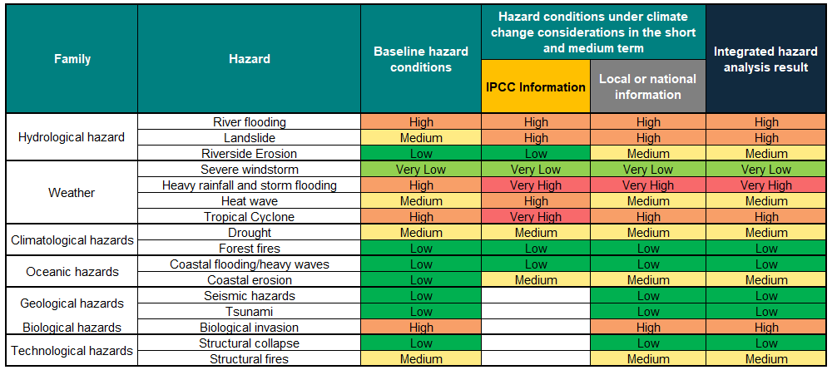
Worksheet 5.3 Hazard - Integrated
Worksheet 5.3 Integrated hazard analysis under climate change considerations. Total risk values are displayed: (1) based on the baseline hazard conditions and 2) integrating climate change consideration by IPCC and national or local information.
In this table you should not enter data. Advance to the next tab.

Slide 19
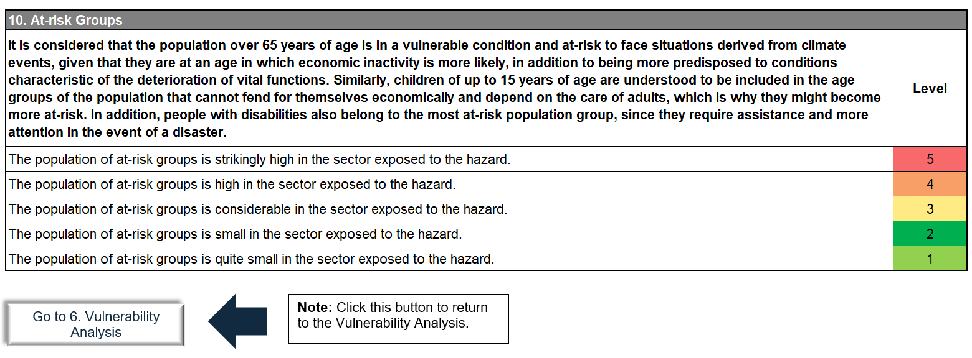
Worksheet 6. Vulnerability Analysis
Worksheet 6. Vulnerability Analysis. Identify the vulnerability indicators that apply to the city being evaluated. Choose the level of vulnerability indicators identified by the prioritized hazards by city (1 is the lowest and 5 is the highest).
To see the details of the indicator, click on the name of the indicator.
Worksheets: Indicator 1-10 explains each vulnerability ranking scale

Slide 20
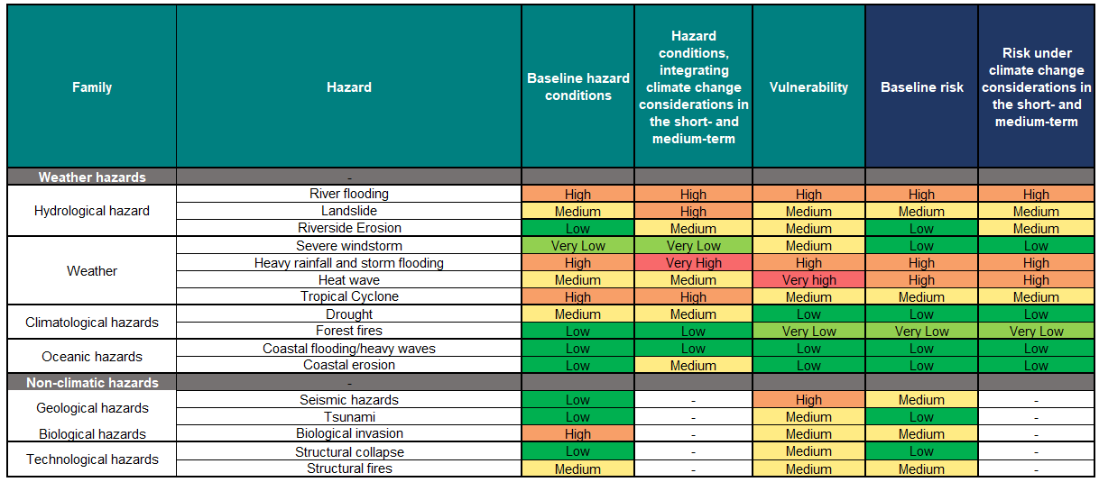
Worksheet 7. Risk Calculation
Worksheet 7. Risk Calculation. At the end of the whole process, different levels of risk can be observed at the crossroads between hazards and vulnerability. NO INPUT NEEDED in this worksheet.
This worksheet displays the results of risk analysis under 1) baseline risk information and 2) climate change considerations in the short- and medium-term.

Slide 21
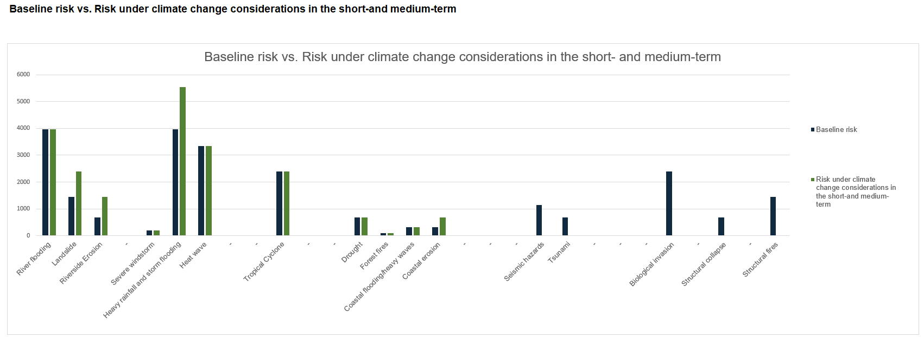
Worksheet 8. Results
Worksheet 8: Results. Finally, the results are displayed in graphs
1) Risk results: comparing the baseline risks and risk under climate change considerations

Slide 22
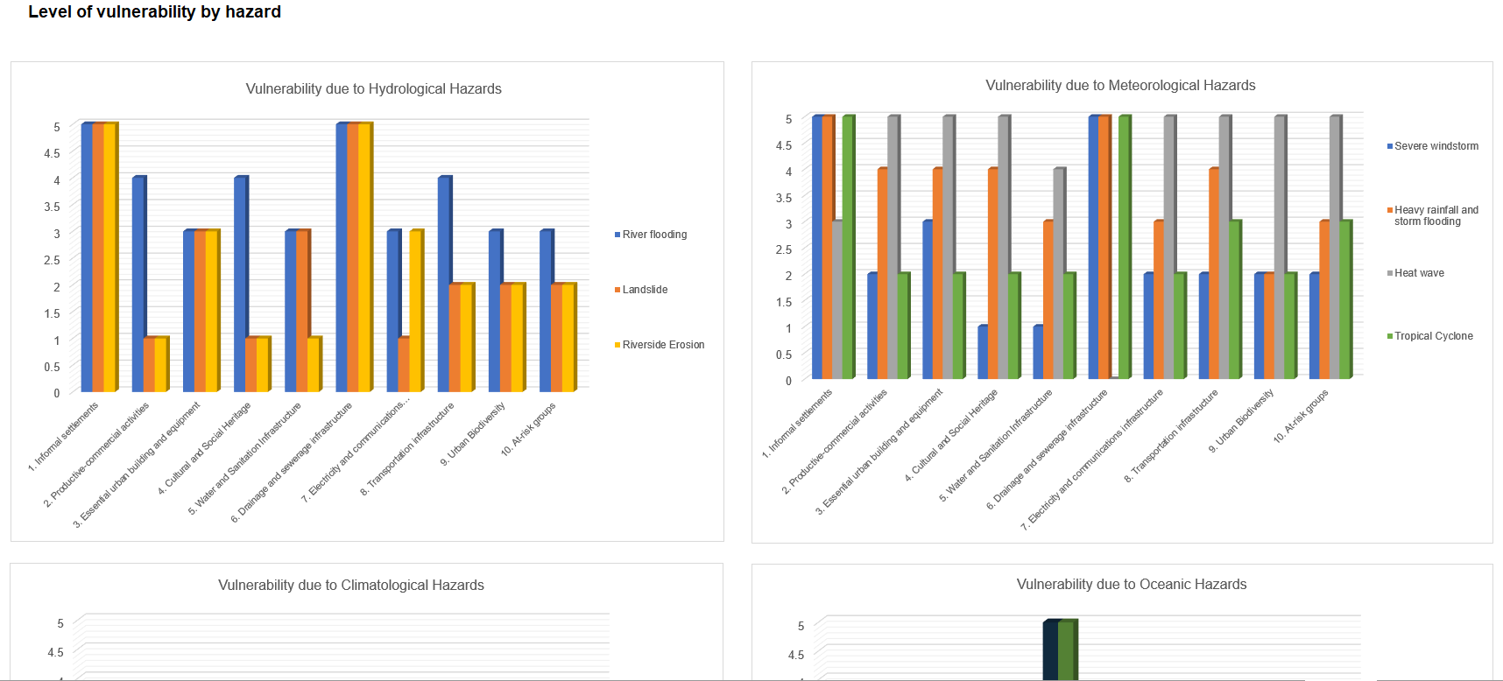
Worksheet 8. Results – cont.
2) Level of vulnerability by different types of hazards

Slide 23
Note on the application of Climate QRE

Slide 24
Very Important note
Climate QRE is a 'rapid’ and ‘simplified’ climate and disaster risk analysis tool. It does not capture all the complexity and nuances of a comprehensive assessment, which often requires more time, resources and a detailed analysis. Hence, it cannot replace the scientific risk modeling and analysis.
It helps to capture quick understanding of risks for immediate decision making.
Apply the ClimateQRE in a multi-stakeholder workshop.
Ensure various sectoral representation in the assessment, especially in the vulnerability analysis.
Best to have the engagement and commitment of Mayor or local government leaders.
Use the risk information to improve local DRR planning and implementation.

Slide 25

Thank You
UNDRR
Global Education and Training Institute (GETI)
4F Songdo G-Tower, 175 Art Center-daero,
Yeonsu-gu, Incheon, Republic of Korea
undrr-incheon@un.org

